Slide 1
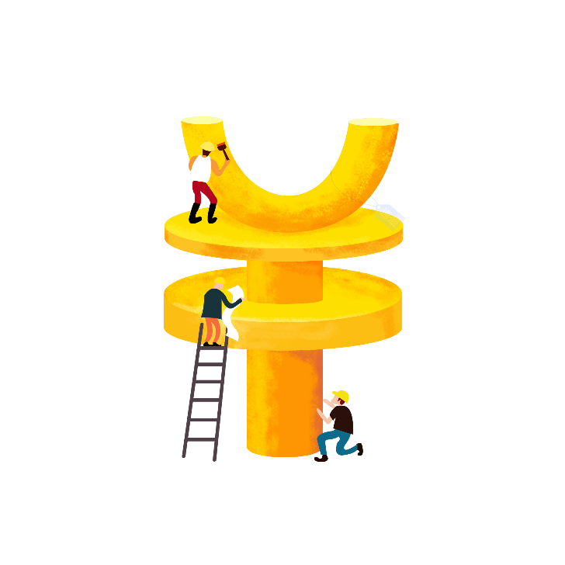

2.5D
BUSINESS
Synergisticallye utilize technical sound portals with frictionless chainsSynergistically
Jpppt.com

Slide 2
1
/Click to add a title/
2
/Click to add a title/
Contents
Synergisticallye utilize technical sound portals with frictionless chainsSynergistically,Synergisticallye utilize technical sound portals with frictionless ChainsSynergistically
3
/Click to add a title/
4
/Click to add a title/

Slide 3

01
Synergisticallye utilize technical sound portals with frictionless chainsSynergistically,Synergistically utilize technically

Slide 4
The title text
The title text
Synergisticallye utilize technical sound portals with, Synergisticallye utilize technical sound, Synergistically utilize technically sound portals with
Synergisticallye utilize technical sound portals with, Synergisticallye utilize technical sound, Synergistically utilize technically sound portals with
A
B
C
D
Synergisticallye utilize technical sound portals with, Synergisticallye utilize
Synergisticallye utilize technical sound portals with, Synergisticallye utilize
Synergisticallye utilize technical sound portals with, Synergisticallye utilize
Synergisticallye utilize technical sound portals with, Synergisticallye utilize

Slide 5
The title text
A.
The title text
The title text
B.
The title text
Synergisticallye utilize technical sound portals with, Synergisticallye utilize technical sound, Synergistically utilize technically sound,Synergisticallye utilize technical sound portals with, Synergistically utilize technically sound, Synergistically utilize technically sound
C.
The title text
D.
The title text

Slide 6
The title text
Synergisticallye utilize technical sound portals with, Synergistically, Synergistically utilize technically sound portals with, Synergistically
Synergisticallye utilize technical sound portals with, Synergistically, Synergistically utilize technically sound portals with, Synergistically
Synergisticallye utilize technical sound portals with, Synergistically, Synergistically utilize technically sound portals with, Synergistically
Synergisticallye utilize technical sound portals with, Synergistically, Synergistically utilize technically sound portals with, Synergistically

Slide 7
The title text
01.
02.
The title text
Synergisticallye utilize technical sound portals with, Synergisticallye utilize technical sound, Synergistically utilize technically sound portals with
Synergisticallye utilize technical sound portals with, Synergisticallye utilize technical sound, Synergistically utilize technically sound portals with
Synergisticallye utilize technical sound portals with, Synergisticallye utilize technical sound, Synergistically utilize technically sound portals with

Slide 8
02
Synergisticallye utilize technical sound portals with frictionless chainsSynergistically,Synergistically utilize technically

Slide 9
The title text
Synergisticallye utilize technical sound portals with, Synergisticallye utilize technical sound, Synergistically utilize technically sound
Synergisticallye utilize technical sound portals with, Synergisticallye utilize technical sound, Synergistically utilize technically sound
Synergisticallye utilize technical sound portals with, Synergisticallye utilize technical sound, Synergistically utilize technically sound
Synergisticallye utilize technical sound portals with, Synergisticallye utilize technical sound, Synergistically utilize technically sound

Slide 10
The title text
1
/Add a title/
The title text
Synergisticallye utilize technical sound portals with, Synergisticallye utilize technical sound, Synergistically utilize technically sound
Synergisticallye utilize technical sound portals with, Synergisticallye utilize technical sound, Synergistically utilize technically sound
Synergisticallye utilize technical sound portals with, Synergistically, Synergistically utilize technically sound portals with, Synergistically
Synergisticallye utilize technical sound portals with, Synergistically, Synergistically utilize technically sound portals with, Synergistically

Slide 11
The title text
Synergisticallye utilize technical sound portals with, Synergistically, Synergistically utilize
Synergisticallye utilize technical sound portals with, Synergistically, Synergistically utilize
Synergisticallye utilize technical sound portals with, Synergistically, Synergistically utilize
The title text

Slide 12

01.
02.
03.
Synergisticallye utilize technical sound portals with, Synergisticallye utilize technically sound,Synergisticallye utilize sound portals with, Synergistically utilize technically sound
Synergisticallye utilize technical sound portals with, Synergisticallye utilize technically sound,Synergisticallye utilize sound portals with, Synergistically utilize technically sound
Synergisticallye utilize technical sound portals with, Synergisticallye utilize technically sound,Synergisticallye utilize sound portals with, Synergistically utilize technically sound

Slide 13
The title text
Synergisticallye utilize technical sound portals with, Synergisticallye utilize technical sound, Synergistically utilize technically sound
Synergisticallye utilize technical sound portals with, Synergisticallye utilize technical sound, Synergistically utilize technically sound
Synergisticallye utilize technical sound portals with, Synergisticallye utilize technical sound, Synergistically utilize technically sound
Synergisticallye utilize technical sound portals with, Synergisticallye utilize technical sound, Synergistically utilize technically sound

Slide 14

The title text
01.
The title text
03.
The title text
Synergisticallye utilize technical sound portals with, Synergisticallye utilize technically sound,
Synergisticallye utilize technical sound portals with, Synergisticallye utilize technically sound,
02.
The title text
04.
The title text
Synergisticallye utilize technical sound portals with, Synergisticallye utilize technically sound,
Synergisticallye utilize technical sound portals with, Synergisticallye utilize technically sound,

Slide 15
03
Synergisticallye utilize technical sound portals with frictionless chainsSynergistically,Synergistically utilize technically

Slide 16
The title text
The title text
Synergisticallye utilize technical sound portals with, Synergistically, Synergistically utilize technically sound portals with, Synergistically
Synergisticallye utilize technical sound portals with, Synergistically, Synergistically utilize technically sound portals with, Synergistically

Slide 17

01.
The title text
02.
The title text
Synergisticallye utilize technical sound portals with, Synergisticallye utilize technically sound
Synergisticallye utilize technical sound portals with, Synergisticallye utilize technically sound
03.
The title text
04.
The title text
Synergisticallye utilize technical sound portals with, Synergisticallye utilize technically sound
Synergisticallye utilize technical sound portals with, Synergisticallye utilize technically sound

Slide 18
The title text
The title text
The title text
The title text
Synergisticallye utilize technical sound portals with, Synergisticallye utilize technical sound, Synergistically utilize technically sound portals with
Synergisticallye utilize technical sound portals with, Synergisticallye utilize technical sound, Synergistically utilize technically sound portals with
Synergisticallye utilize technical sound portals with, Synergisticallye utilize technical sound, Synergistically utilize technically sound portals with

Slide 19
The title text
Synergisticallye utilize technical sound portals with, Synergisticallye utilize technically sound,Synergisticallye utilize sound portals with, Synergistically utilize technically sound
100%
50%
Synergisticallye utilize technical sound portals with, Synergisticallye utilize technically sound,Synergisticallye utilize sound portals with, Synergistically utilize technically sound
80%
Synergisticallye utilize technical sound portals with, Synergisticallye utilize technically sound,Synergisticallye utilize sound portals with, Synergistically utilize technically sound

Slide 20

Synergisticallye utilize technical sound portals with, Synergistically utilize technically
A.
The title text
B.
Synergisticallye utilize technical sound portals with, Synergistically utilize technically
Synergisticallye utilize technical sound portals with, Synergisticallye utilize technical sound, Synergistically utilize technically sound
C.
Synergisticallye utilize technical sound portals with, Synergistically utilize technically
D.
Synergisticallye utilize technical sound portals with, Synergistically utilize technically

Slide 21
04
Synergisticallye utilize technical sound portals with frictionless chainsSynergistically,Synergistically utilize technically

Slide 22

The title text
The title text
The title text
Synergisticallye utilize technical sound portals with, Synergisticallye utilize technical sound, Synergistically utilize technically sound
Synergisticallye utilize technical sound portals with, Synergisticallye utilize technical sound, Synergistically utilize technically sound

Slide 23
The title text
The title text
Synergisticallye utilize technical sound portals with, Synergisticallye utilize technical sound, Synergistically utilize technically sound
Synergisticallye utilize technical sound portals with, Synergisticallye utilize technical sound, Synergistically utilize technically sound

Slide 24
The title text
Synergisticallye utilize technical sound portals with, Synergisticallye utilize technical sound, Synergistically utilize technically sound
Synergisticallye utilize technical sound portals with, Synergisticallye utilize technical sound, Synergistically utilize technically sound
01
04
Synergisticallye utilize technical sound portals with, Synergisticallye utilize technical sound, Synergistically utilize technically sound
Synergisticallye utilize technical sound portals with, Synergisticallye utilize technical sound, Synergistically utilize technically sound
02
05
Synergisticallye utilize technical sound portals with, Synergisticallye utilize technical sound, Synergistically utilize technically sound
Synergisticallye utilize technical sound portals with, Synergisticallye utilize technical sound, Synergistically utilize technically sound
03
06

Slide 25
THANK
YOU
Synergisticallye utilize technical sound portals with frictionless chainsSynergistically
Jpppt.com

